Slide 1
Week 7 Presentation
Team 16
By: James Panhorst, Jibin Mathews, Josh Ramirez, Alex Holmes

Slide 2
Objectives
Develop an autonomous robot that can navigate racetrack and avoid obstacles
Must be able to:
Follow Metallic Tape (IPS: LJ18A3-8-Z/BX)
Avoid Obstacles (IR Sensor: GP2Y0A60SZ0F)
Detect/ proceed actions with corresponding colors (Color Light-to-Frequency TCS3200)
Green: Go
Blue: Slow Down
Red: Stop
Design Printed Circuit Boards (PCB) and utilize with project

Slide 3
Approaches for objectives
IPS Sensor needs to be adjusted to the right height
Corner Ramp
Is the positioning of IPS affected?
Is the ride height of the Rover 5 affected?
Alternative Path
How can the robot turn while still knowing to follow the metallic line using IPS?
More proximity sensors(Maybe 4)
Color Sensor
Positioning (Underneath, Behind, In-front)

Slide 4
Deliverables For Week 7
Finished the hardware for the IR sensor and successfully connected it to a comparator.
Implemented a 2nd IPS sensor and began connectivity tests to the Basys3.
Continued research on the color sensor.
Finished trial design of the base for the rover

Slide 5
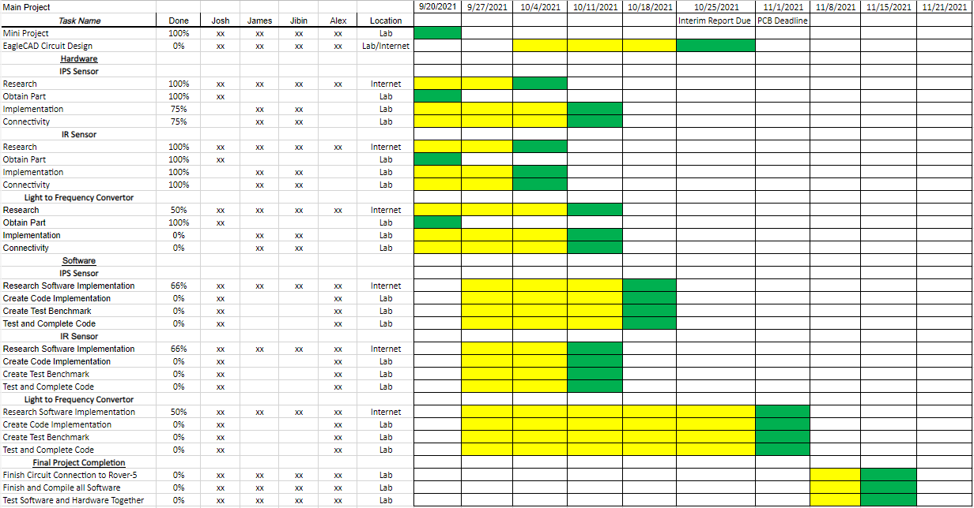
Gantt Chart

Slide 6
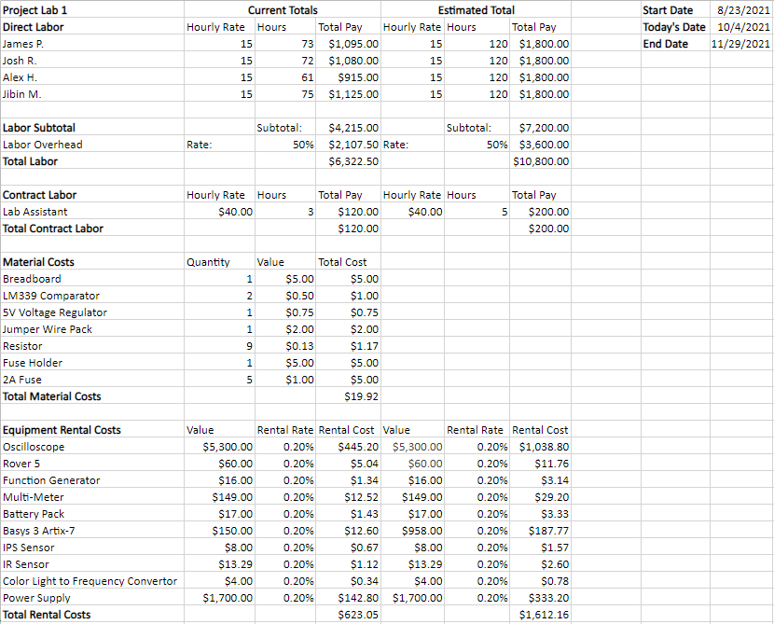
Budget Sheet

Slide 7
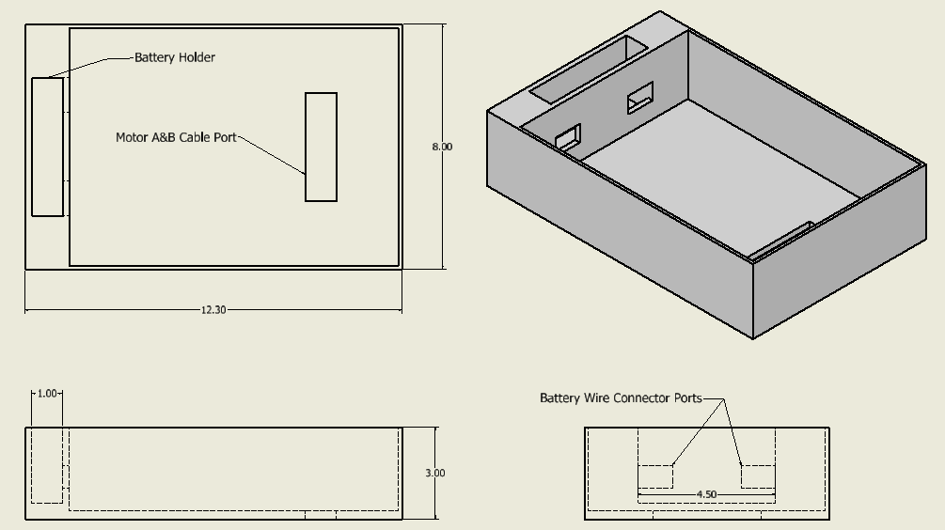
Rover 5 Base Model

Slide 8
IR Sensor Details
Utilized an LM339 comparator to compare the IR sensor output to a fixed voltage.
The fixed voltage is a result of a voltage divider, resulting in 2.0V connected to the inverting terminal of the comparator.
The non-inverting terminal is connected to the IR sensor output.
A pull-up resistor is connected from the IR output to 3.3V supplied from the Basys3 board.
As a result, when the IR sensor outputs more than 2.0V when an object comes within 20cm of it, the comparator outputs a signal high.

Slide 9
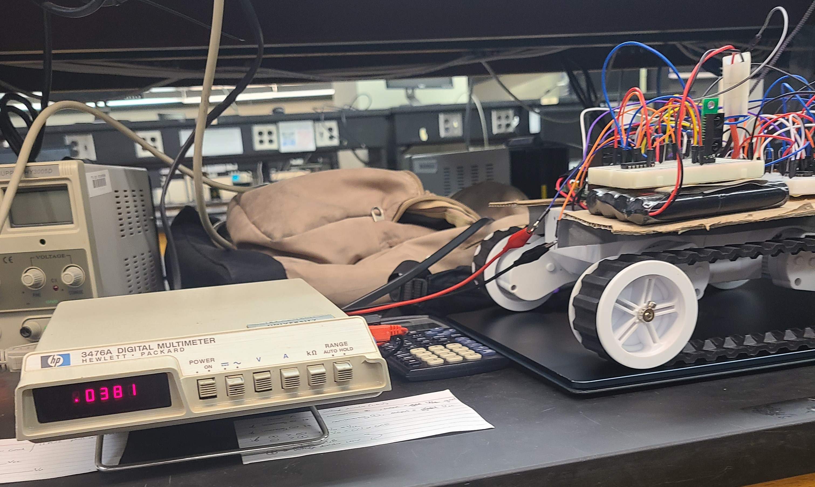
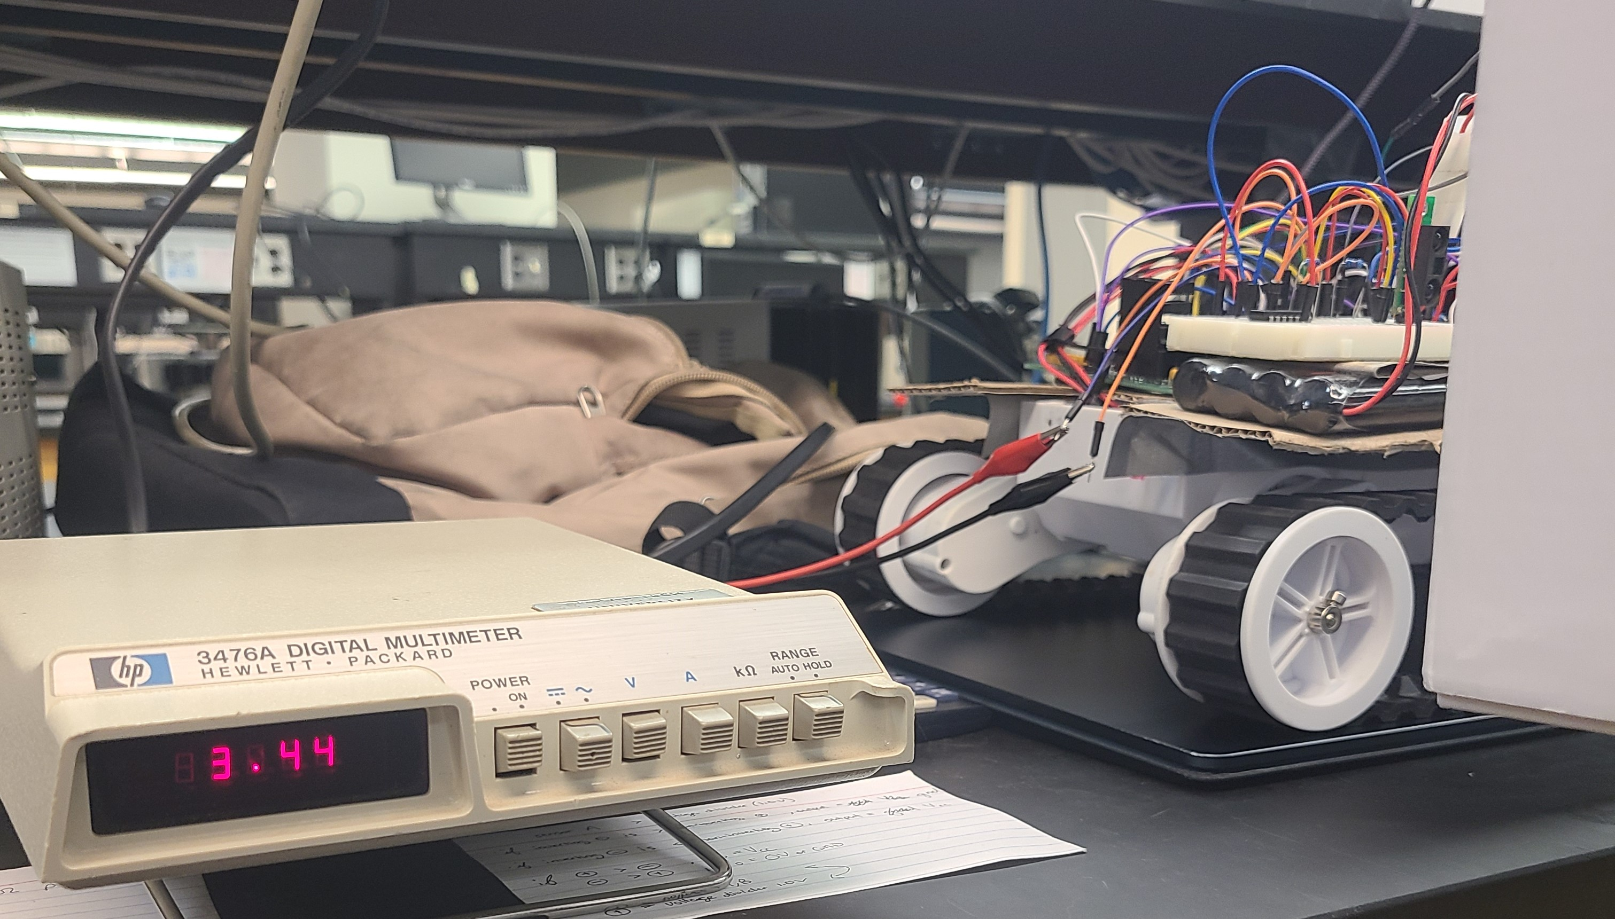
IR Sensor

Slide 10
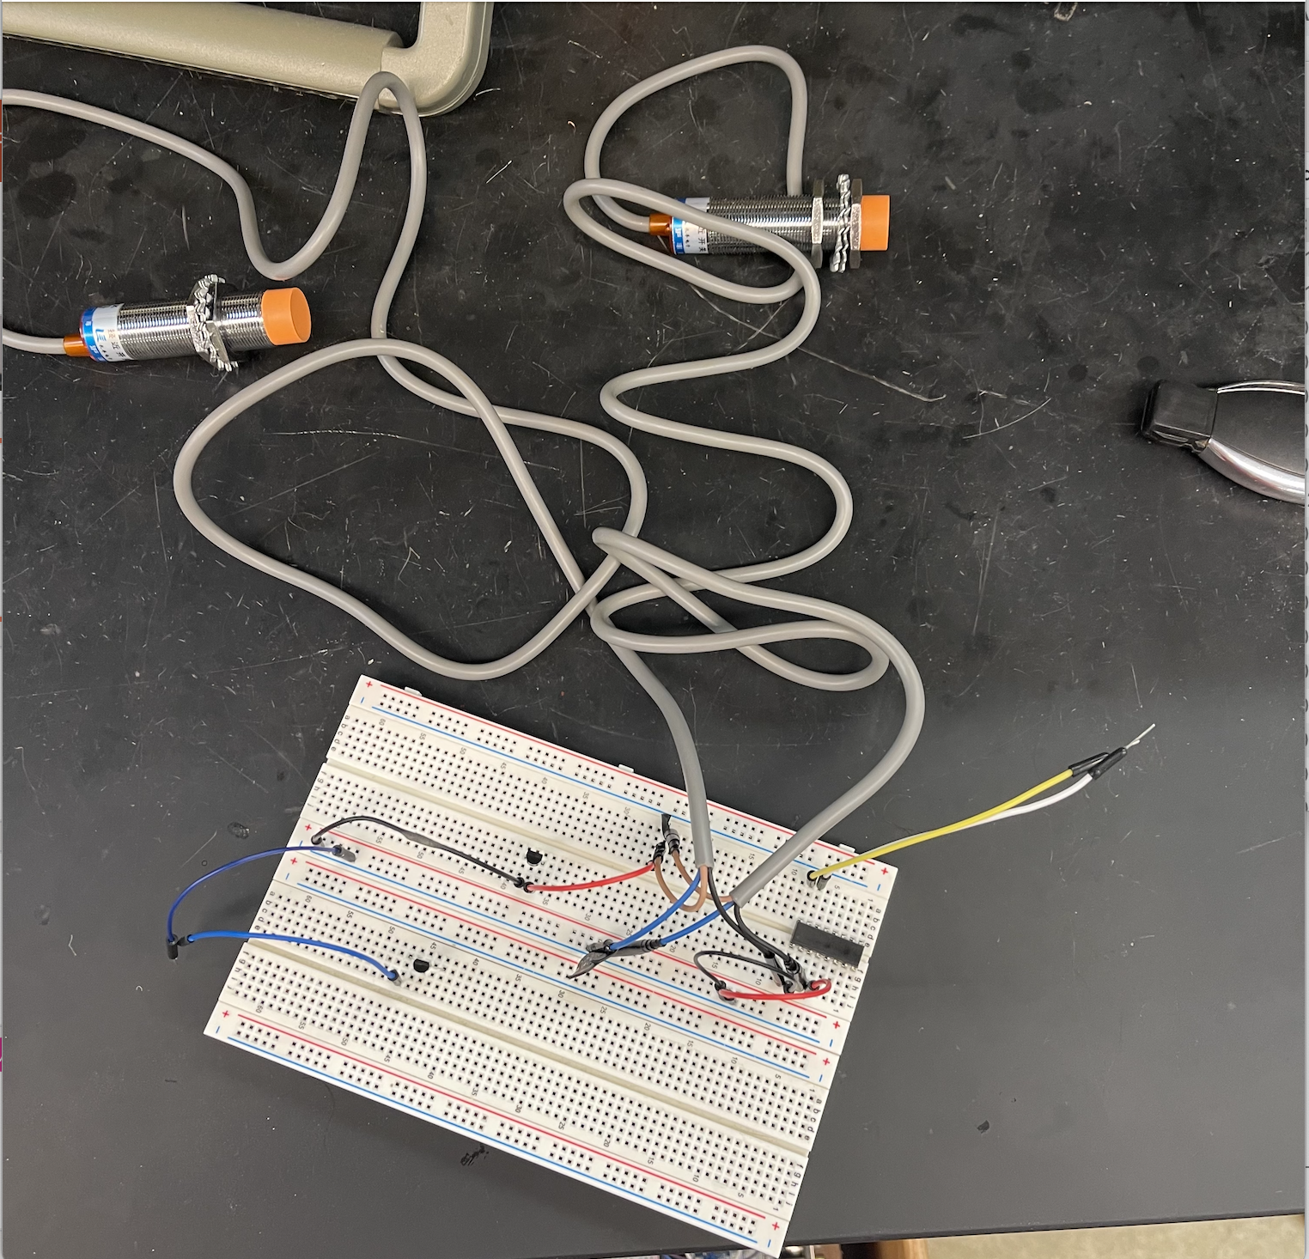
Inductive Proximity Sensor
Methods to implement proximity sensors to Basys3 Board?
-Voltage Divider
-Optocoupler

Slide 11
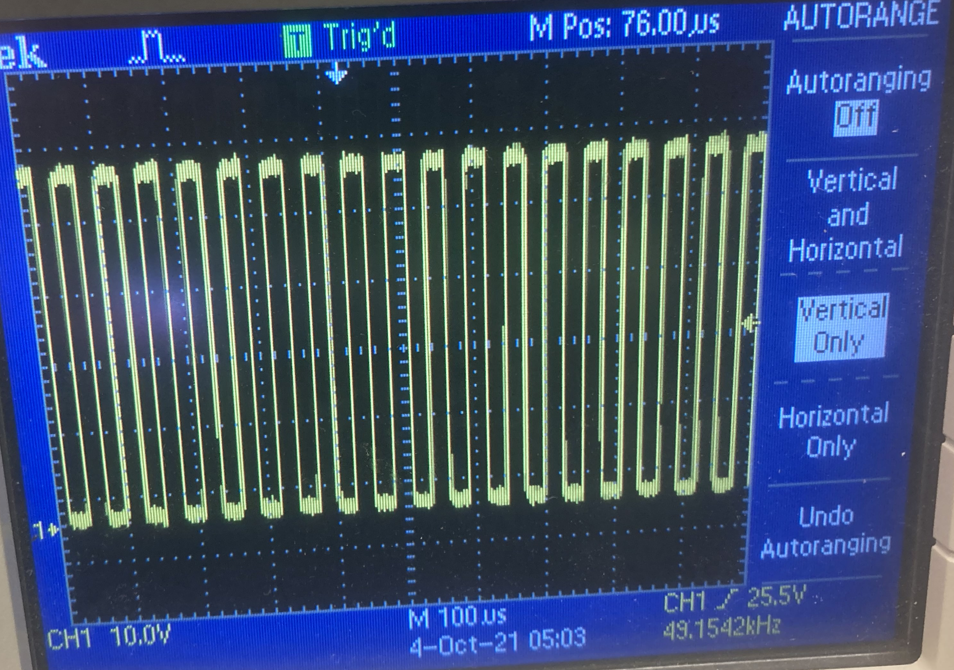
TCS3200 frequency

Slide 12
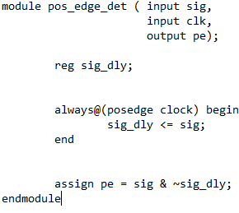
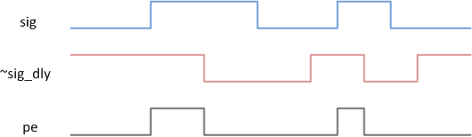
Pulse detection
https://www.chipverify.com/verilog/verilog-positive-edge-detector

Slide 13
Next Week’s Deliverables
Finish testing and implementing code for the IR sensor.
Finish hooking up the IPS sensors to the Basys3.
Complete software implementations of the IPS sensors.
Make improvements/ changes to the trial base and print (3-D printer)
Implement IPS and IR Sensor mounting to the base

Slide 14
References
[1] IR Sensor (GP2Y0A60SZ0F) datasheet. https://www.pololu.com/file/0J812/gp2y0a60szxf_e.pdf.
[2] IPS Sensor (LJ18A3-8-Z/BX). http://files.microjpm.webnode.com/200003722-858c88684b/Condutive%20Proximity%20Switch%20Series.pdf
[3] Color Light-To-Frequency Converter (TCS3200) datasheet. https://www.mouser.com/catalog/specsheets/tcs3200-e11.pdf
[4] TCS3200 Tester Code. https://randomnerdtutorials.com/arduino-color-sensor-tcs230-tcs3200/

Slide 15

Questions

